Slide 1


Project name: Remote Thermal Viewing within High Voltage Team members: Blake Bagley, Julia Garcia, Erica Mathew

Slide 2
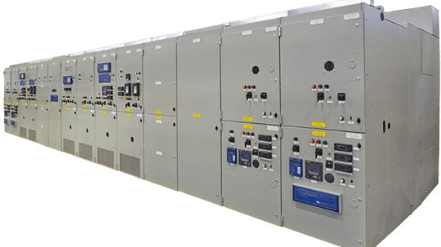

Project description
Problem statement: “As industry demand grows, space inside medium voltage switchgear has become increasingly limited. Manufacturers are required to fit more devices and wires within the same limited space. Additionally, manufacturers are now being asked to include a remote viewing system within the switchgear to monitor a physical ground switch. This ground switch is physically blocked, by wires, from the view of the operator.”
Notes:
Erica: Our project sponsor is powell industries which is a “Powell Industries designs and manufactures equipment like switchgear, circuit breakers, and power management systems that help safely control and distribute electrical power in multiple different industries
Switchgears are Switchgears are devices that control and protect electrical circuits by turning power on or off and preventing damage during electrical faults.
Powell industries designs/maufactures
explain switchgears
explain project

Slide 3
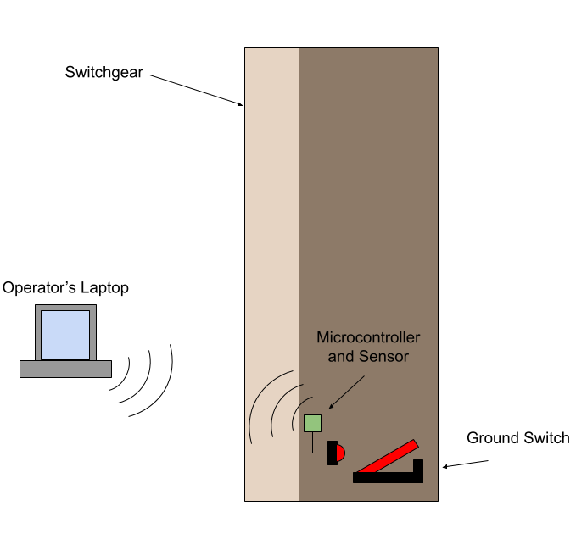
Project Solution Description
Solution proposal: Our solution to this problem is to create a thermal remote viewing system that an operator can connect to through Wi-Fi, allowing for operators to confirm the grounding switch is either open or closed through video and automation. This will make switchgear operators jobs safer and more convenient.
Notes:
Blake

Slide 4
System Overview
Power Supply
Thermal Sensor
Battery
RTMP
Website
Converters
Microcontroller
Julia, Blake, Erica
Notes:
Julia

Slide 5
Task partition
Julia: Design the power supply and overall hardware of the system.
Blake: Microcontroller coding and ML
Erica: Creating Web Application for users to interact with
Notes:
erica

Slide 6
Thermal Sensor and accompanying PCB (Julia)
Accomplishments since the last presentation <18> hrs (track your hours) | Ongoing progress/problems and plans until the next presentation
Completed Subsystem Intro Project
Designed and simulated buck converters
Finished the PCB schematic
created footprints for components
Routing the PCB
will finish today, in order to run a design check in lab
Need to run a design check with the team
Plan to order the PCB as soon as we finish the design check
Notes:
jay update: finished designing the buck converters, ran simulations, will be ordering parts on monday

Slide 7
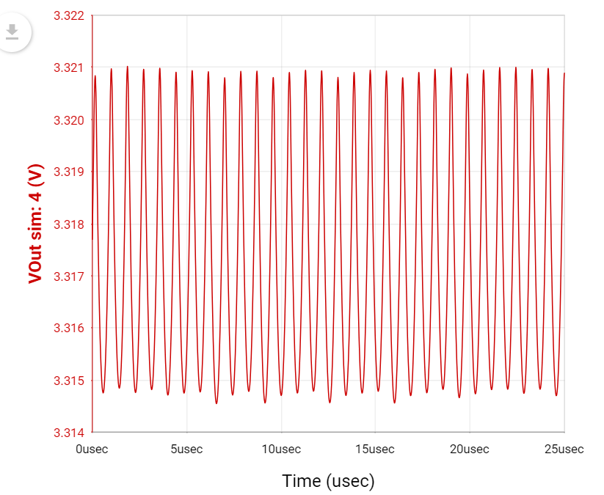
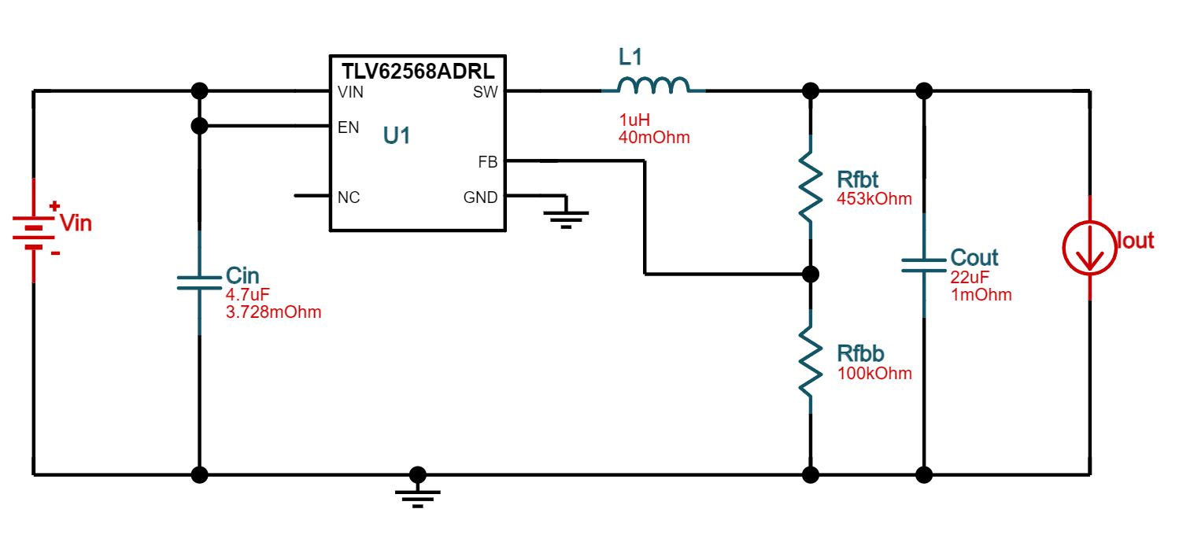
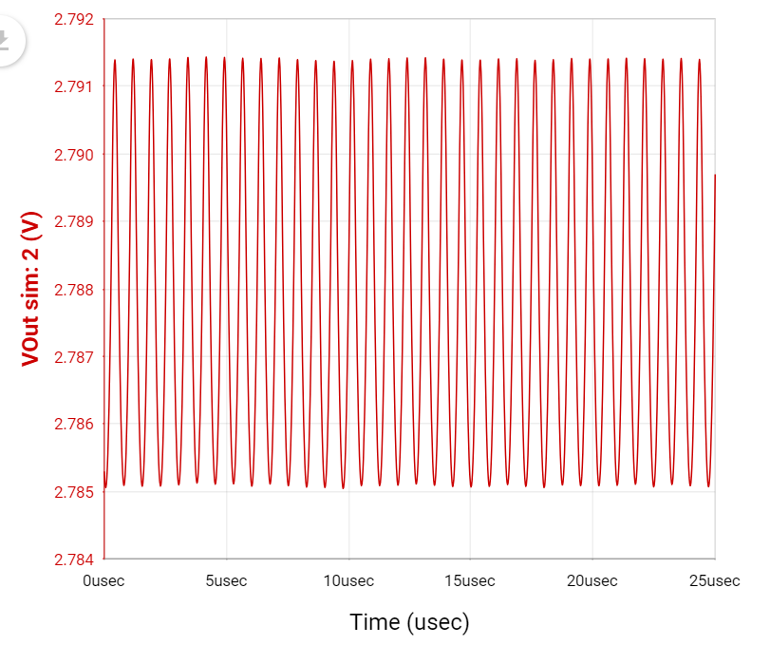
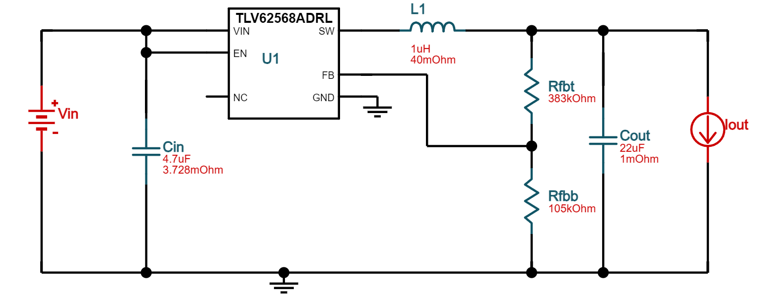
Buck Converters

Slide 8
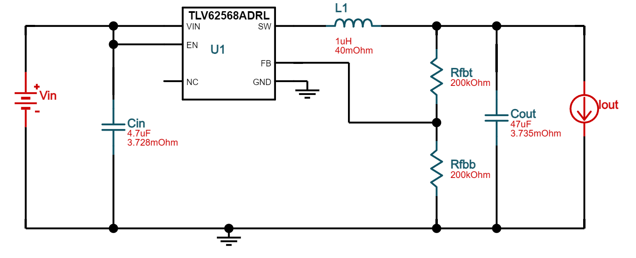
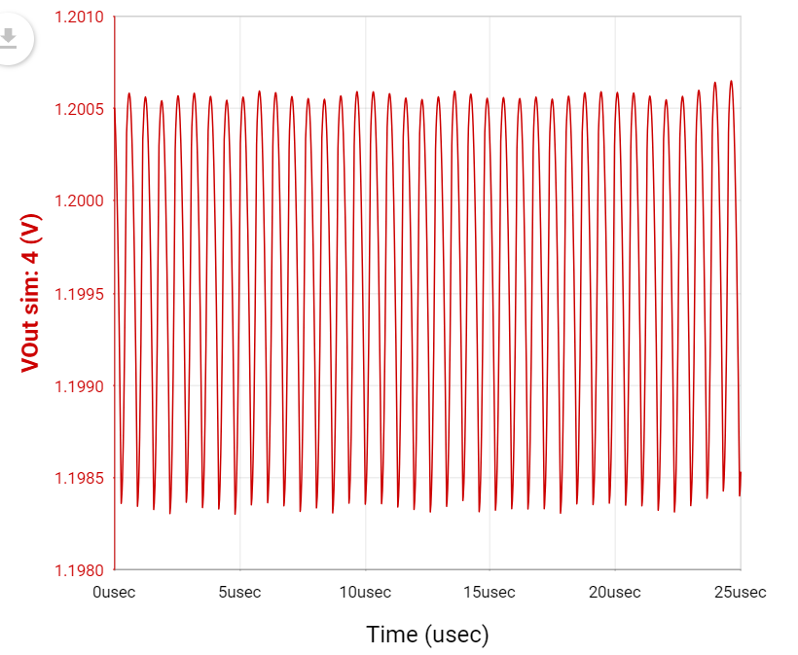
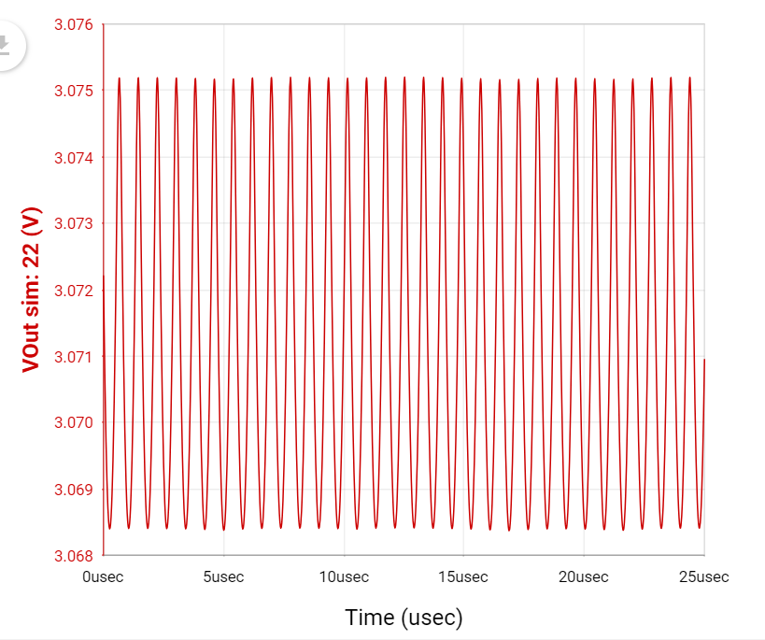
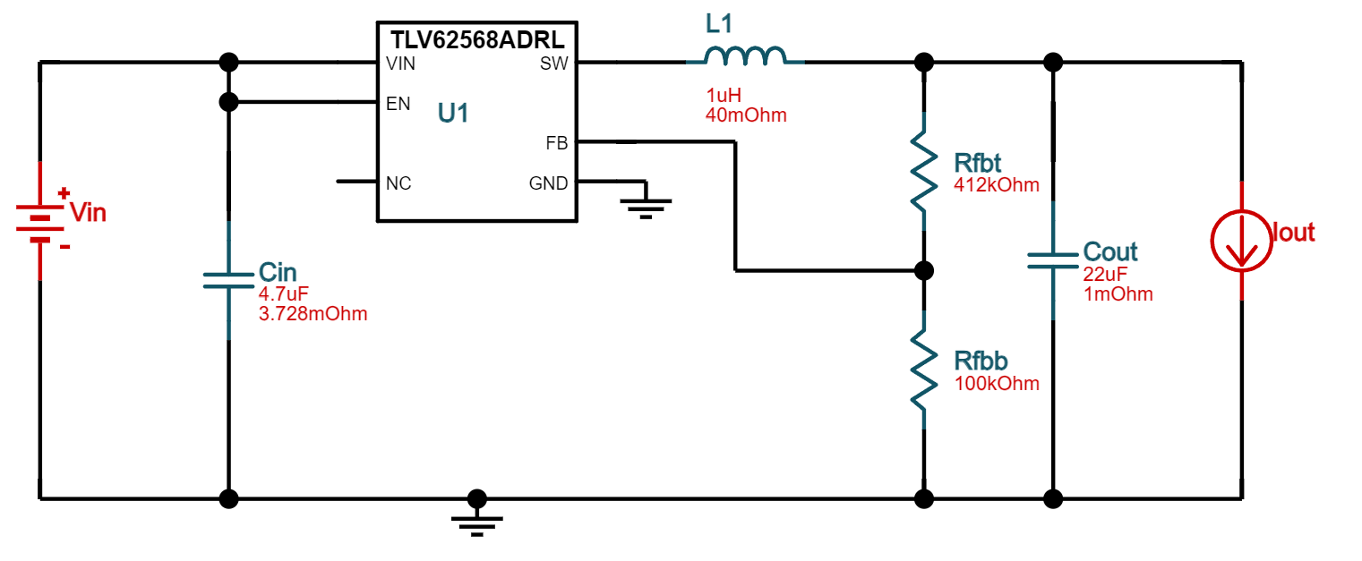
Buck Converters

Slide 9
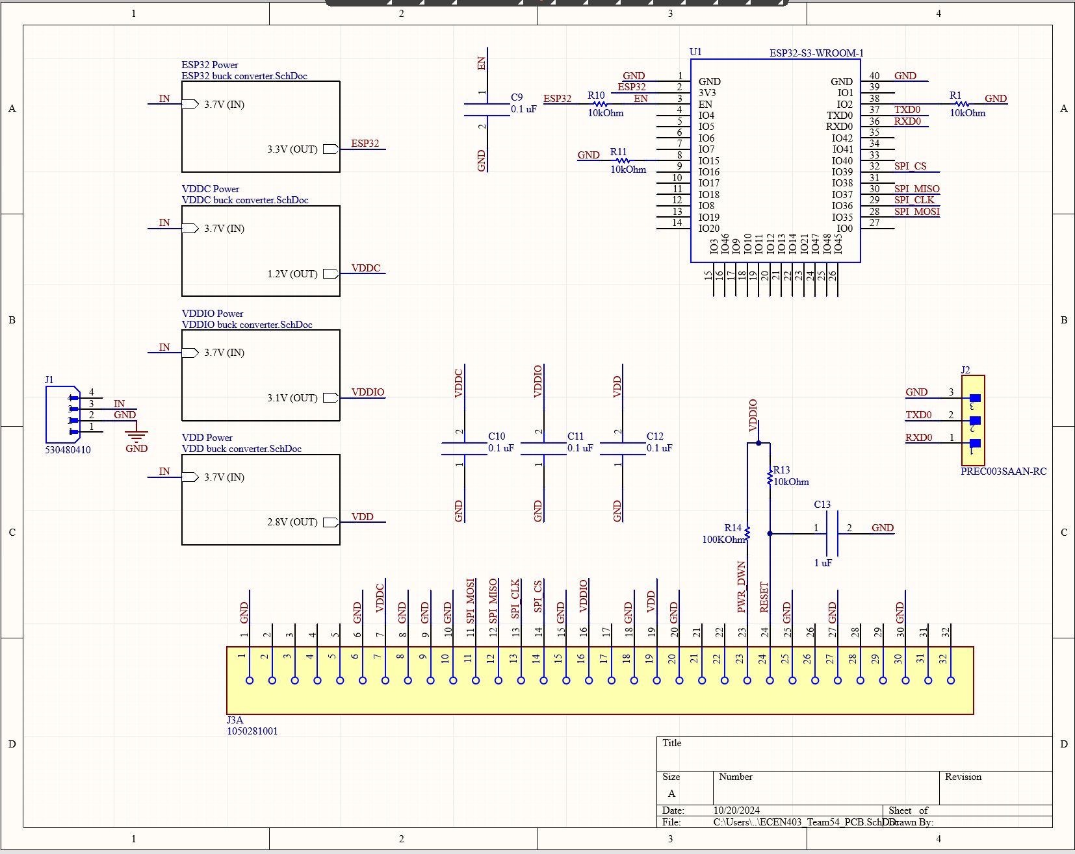
Schematic

Slide 10
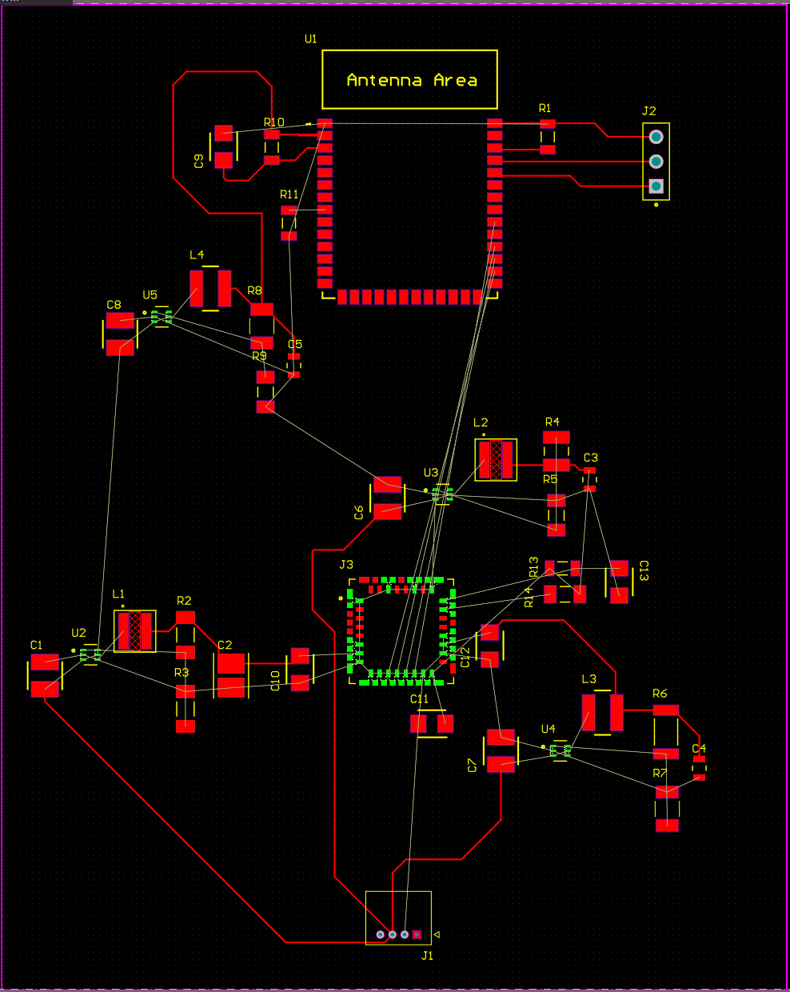
PCB

Slide 11
Microcontroller (Blake)
Accomplishments since the last presentation <15> hrs (track your hours) | Ongoing progress/problems and plans until the next presentation
*Both Microcontroller and ML intro projects are done
*Switch-State Determination block is complete
Starting on Image Processing
Problems:
Figuring out how use tensorflow properly on a microcontroller
Coding Microcontroller to use a camera and Wifi
Problems:
A lot of information online on these topics use Arduino IDE and not ESP-IDF

Slide 12
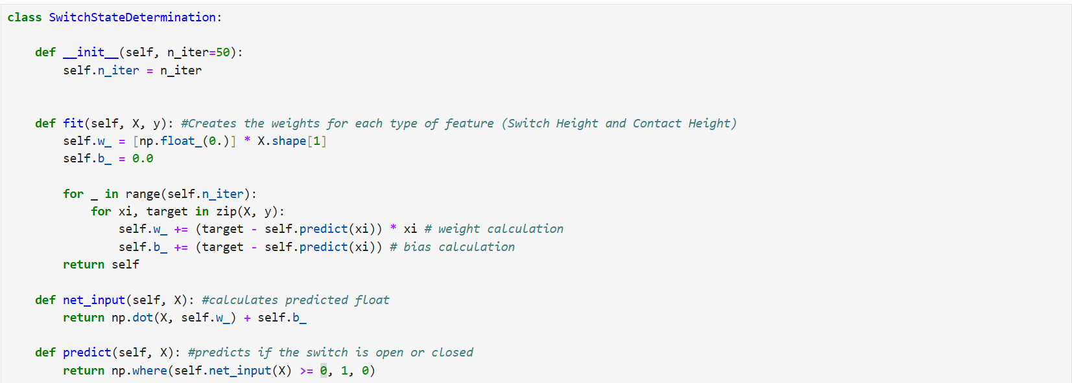
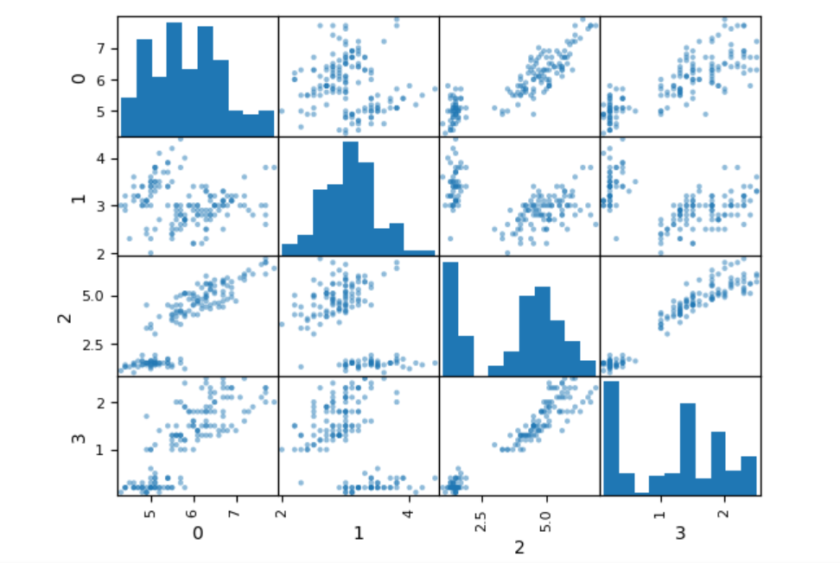
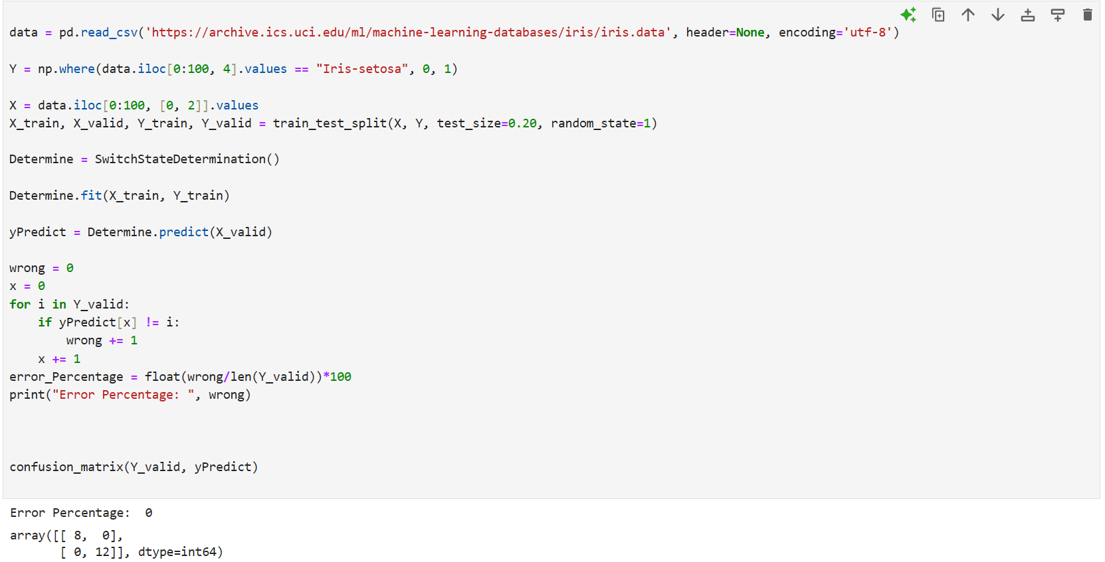
Switch-State Determiner

Slide 13

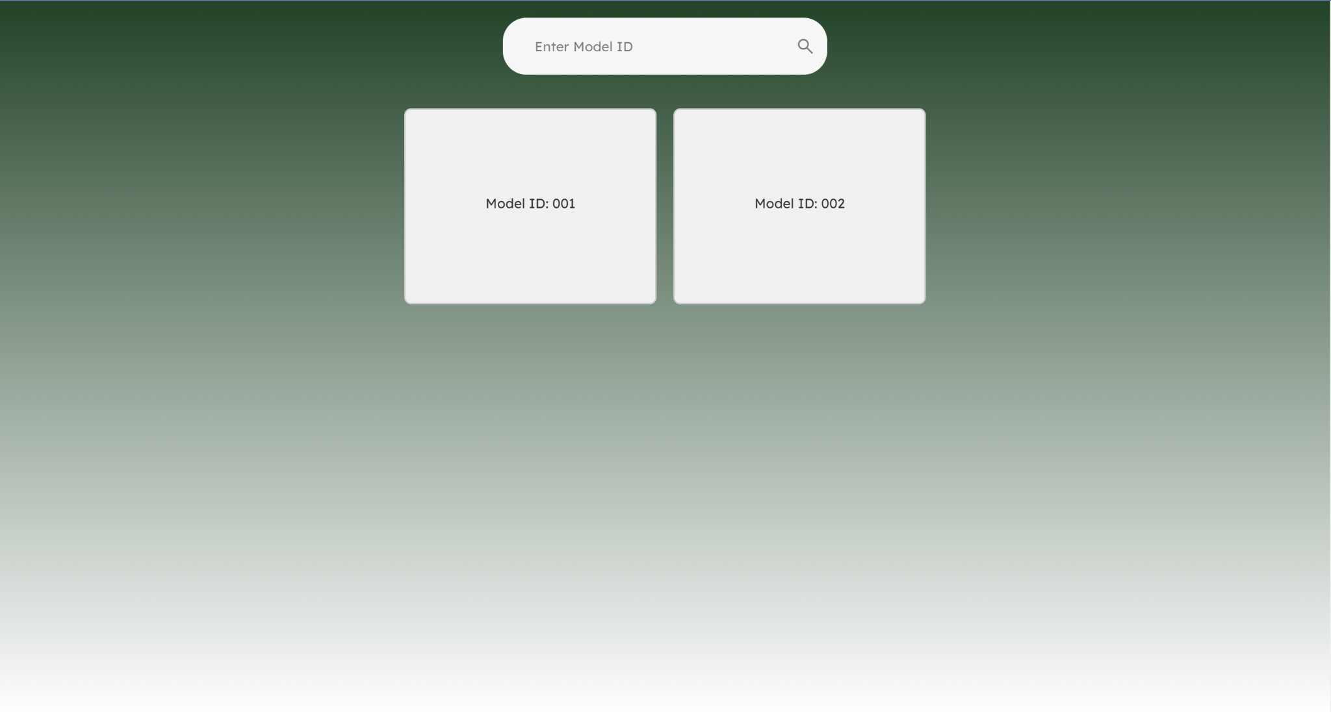
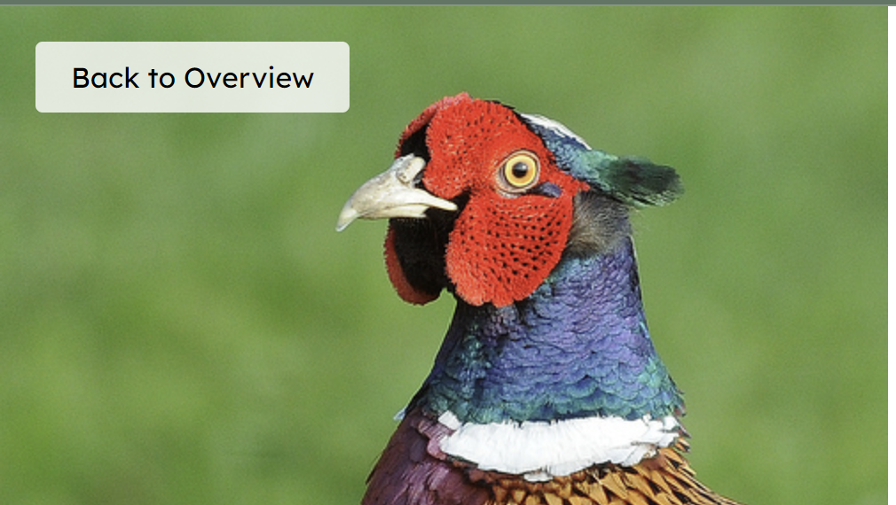
Web Application (Erica)
Accomplishments since the last presentation <24> hrs (track your hours) | Ongoing progress/problems and plans until the next presentation
Got search functionality properly working
Researched best method for fetching live video data
Web sockets: Server reads image and send them to client (browser)
Currently have website properly functioning with 1000 image zip file
Currently working on creating a buildable map for users to drag and drop blocks to match the physical layout of their switchgear setup
Notes:
We chose RTMP/embedding streams because it allows us to easily integrate live streaming without needing to deal with the complexity of setting up RTMP directly. Platforms like YouTube Live already use RTMP behind the scenes, so we can embed their stream with minimal effort.
WebRTC is great for real-time communication, but it's too complicated to set up using plain JavaScript, especially for streaming.
WebSockets can handle data streams, but we found it has too many bugs and lacks reliable tools for streaming video efficiently.
im now embedding a livestream from youtube live

Slide 14
Execution plan
 | 9/16/24 | 9/23/24 | 9/30/24 | 10/6/24 | 10/13/24 | 10/20/24 | 10/27/24 | 11/4/24 | 11/11/24 | 11/18/24 | 11/25/24 | 12/5/24
Work on Documentation
Project Parts Ordered
Subsystem Introduction Project |  |  |  |  |  |  |  |  | Not Started
Web Application Strucutre + set up Firebase |  |  |  |  |  |  |  |  | In Progress
Finalize PCB Block Diagram |  |  |  |  |  |  |  |  | Completed
Design Login page |  |  |  |  |  |  |  |  | Behind
Midterm Presentation
Image Recognition Training Data
Buck Converter Design + Simulation
Initial PCB Designed and ordered
Build Homepage that displays live video
Initial PCB Recieved
Switch-State Detection complete
Implement backend for fetching video feeds
Status Update Presentation
Initial PCB Complete
Image Recognition Complete
Create 'Open/Closed' alerts on website
Added website features for user convenience
Image Recognition + Switch-State working together
Final PCB Complete
Final Presentation
Subsystem Demo
Final Report

Slide 15
Validation Plan
Paragraph # | Test Name | Success Criteria | Methodology | STATUS | Engineers
3.2.3.1.2 | Provide Power | Input Voltage reads ~3.7 V, Microcontroller turns on, Sensor turns on | Use multimeter to input voltages | UNTESTED | Julia Garcia
3.2.3.1.2 | Buck Converters | Output to VDDC reads ~1.26 V, Output to VDD reads ~2.88 V, Output to VDDIO reads ~3.1 V, Output to ESP32 reads ~3.6 V | Use multimeter to measure the output voltages | UNTESTED | Julia Garcia
3.2.3.2.2 | Sensor Sending Video | Signal is coming from output | Use a matlab program to read thermal image data | UNTESTED | Julia Garcia
3.2.1.2 | Image Recognition Accuracy (90%) | Make sure the accuracy of the Image Recognition is to standard when close or far, centered or not. | Use pre-made dataset for verification | UNTESTED | Blake Bagley
3.2.1.2 | Switch-State Determination Accuracy (90%) | Make sure the accuracy of the Switch-State Determination Perceptron is up to standard | Use existing linearly separable data as training data and test data | PASS | Blake Bagley
3.2.3.2.2 | Receiving Video from Sensor | Video is being received from the camera through the VSPI pins | Checking GPIO pins for communication | UNTESTED | Blake Bagley
3.2.1.1 | Connection to WiFi | If the ESP32 can make a WiFi connection as an access point or as a station | Searching for ESP32 SSID on a personal laptop. | UNTESTED | Blake Bagley
3.2.1.1 | Sending Video to Website | The ESP32 is able to send an image over WiFi | Have the ESP32 send a video to a personal laptop | UNTESTED | Blake Bagley
3.2.1.4 | Receiving Video | If video is not fetched after 30 seconds, an error will appear. Video should output with no more than 5 second delay. Video should be of correct vertical tower | Send different video live streams and monitor latency | PASS | Erica Mathew
3.2.1.1 | Login-in System | Login with correct credentials and fail with incorrect credentials | Have user create different login credentials to check if they are stored in firebase | PASS | Erica Mathew
3.2.1.1 | Search Bar | Search bar redirects user to the proper video stream | Have user type different ID numbers to test search bar functionality | PASS | Erica Mathew
3.2.1.4 | Video Display Page | Overview Page that displays multiple video streams. Video streams in overview page are clickable to redirect user to zoomed in video feed on a different page | Send different video live streams and have user try to access all of them | PASS | Erica Mathew

